Slide 1

Medical Insurance Cost Prediction
presentation by:-
Anjali Singh
Shivankar
Rohit Singh ​​

Slide 2

About Dataset
This dataset provides information about 100,000 individuals including their demographics, socioeconomic status, health conditions, lifestyle factors, insurance plans, and medical expenditures.

Slide 3
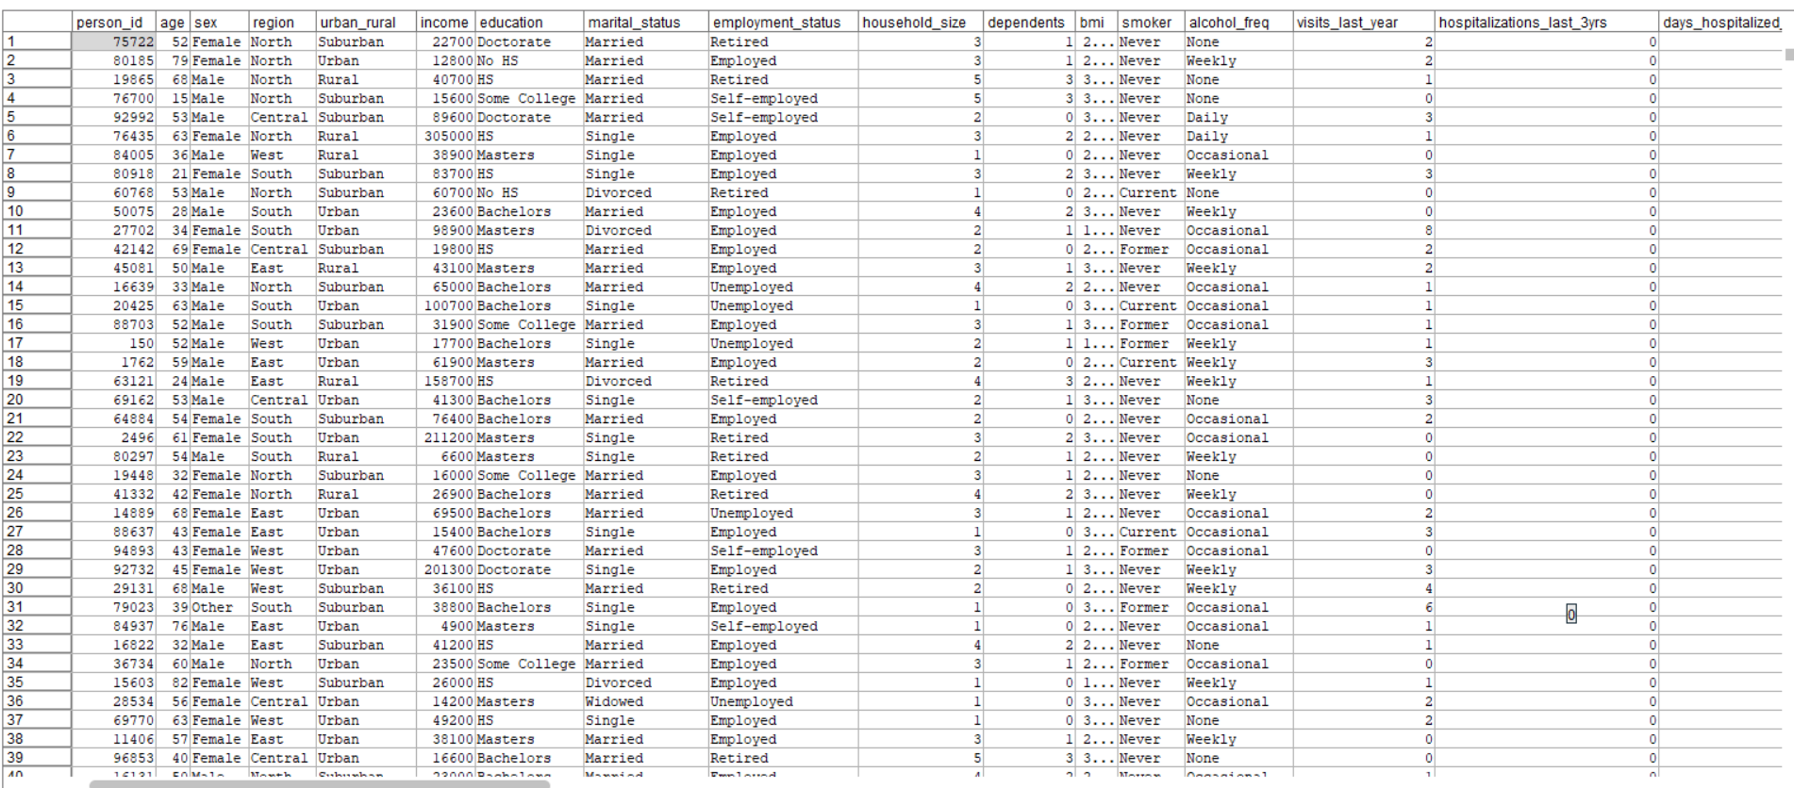
dataset

Slide 4

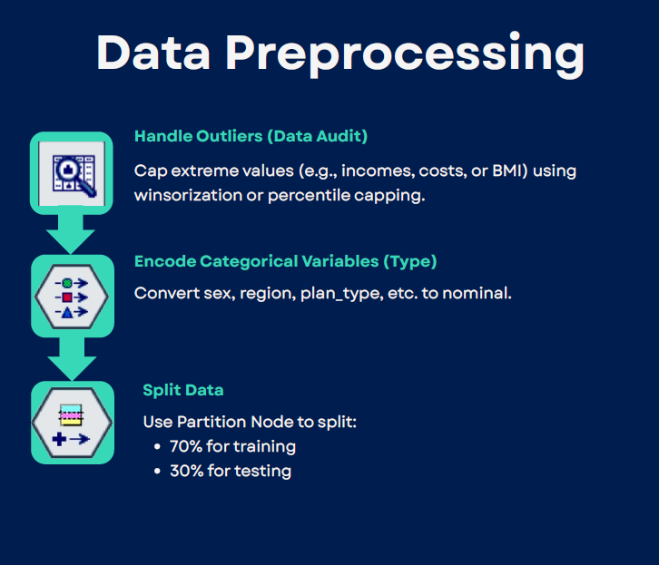

Slide 5
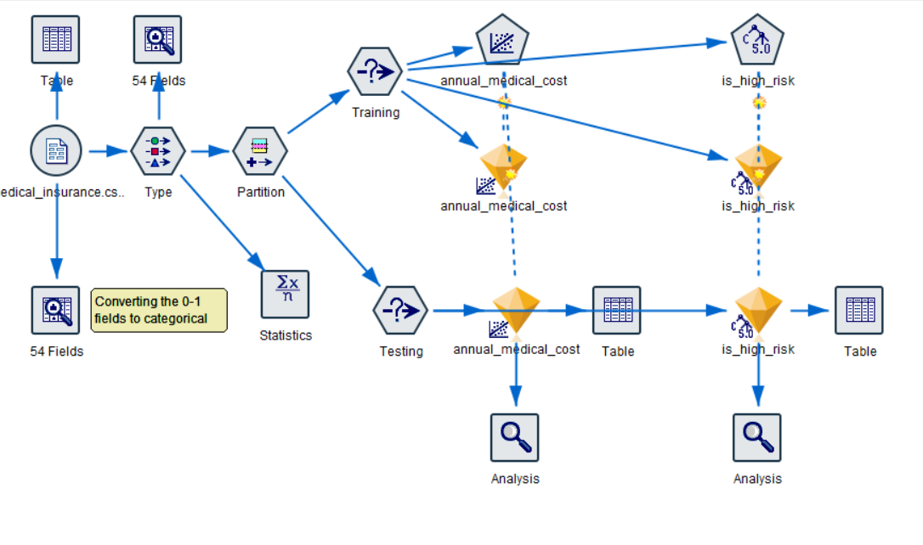
Financials

Slide 6
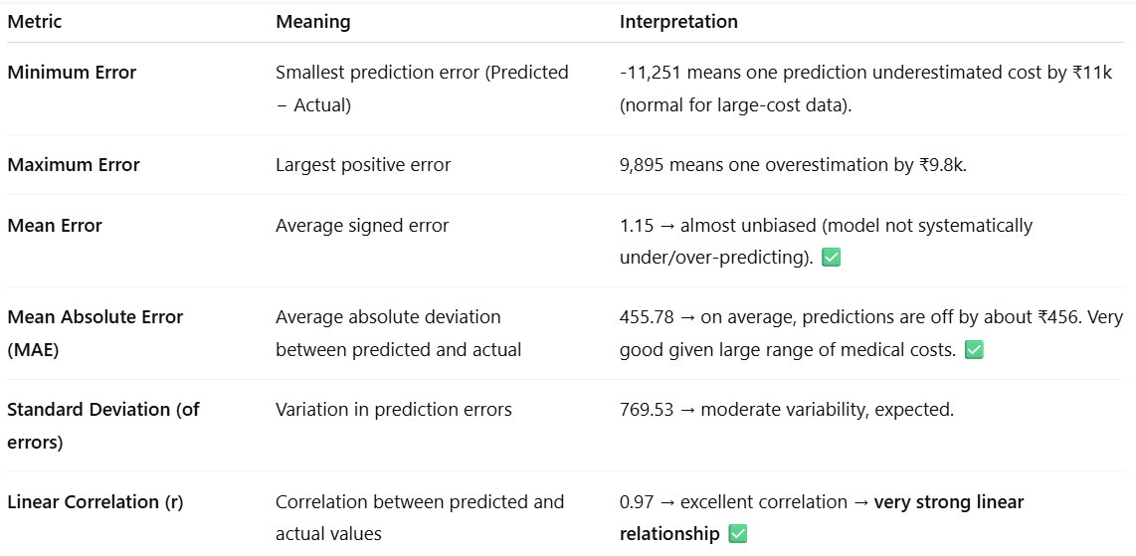
Annual Medical Cost

Slide 7
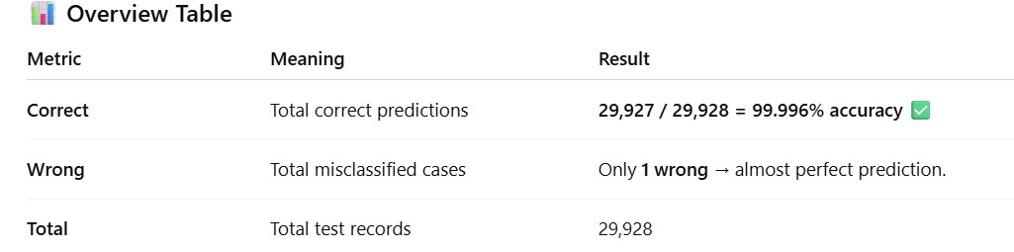
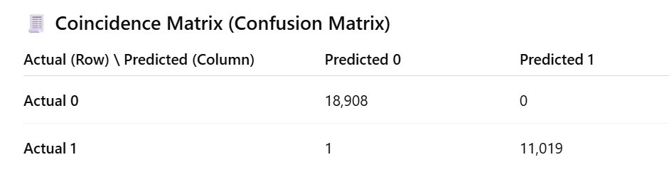
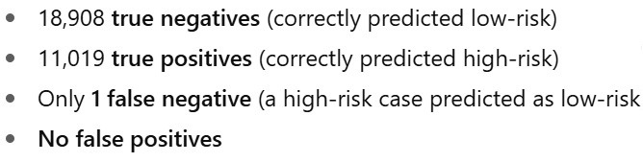
High Risk Prediction

Slide 8

The End

